Slide 1
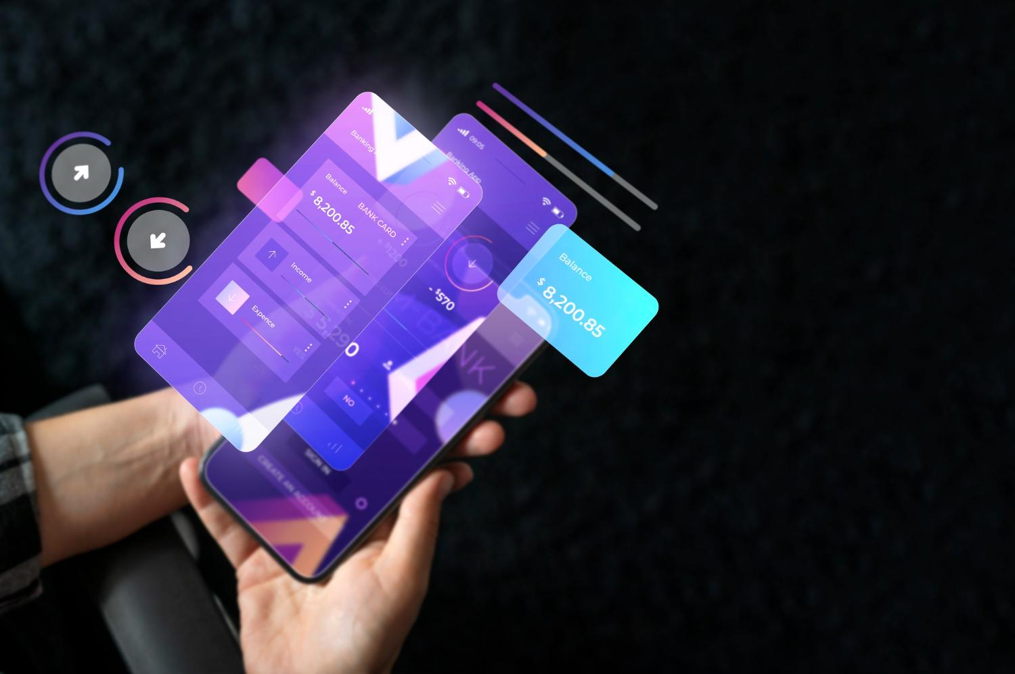
Crafting User-Centric Interfaces: Mastering Advanced Forms, Validation, Accessibility, and Branding
Unleashing the Power of User Experience and Visual Identity
Notes:
Hello everyone, welcome to our session on "Advanced UI Development Techniques”,In this presentation, we will delve into the world of Crafting User-Centric Interfaces: Mastering Advanced Forms, Validation, Accessibility and Branding.We'll cover Advanced Forms, Advanced Validation Techniques, Accessibility and Inclusive Design and Theming and Branding.

Slide 2


Introduction
The Challenge of Modern UI Design ​
​ ​
The Need for Advanced Techniques​
Notes:
The Challenge of Modern UI Design: Creating user interfaces that are not only visually appealing but also functional, accessible, and aligned with brand identity
The Need for Advanced Techniques: Mastering advanced UI techniques becomes crucial to overcome these challenges and craft exceptional user experiences

Slide 3


Advanced Forms and User Interactions
Designing Intuitive and Efficient Forms
Utilizing Advanced Form Controls and Input Fields
Enhancing User Experience with Form Validation and Error Handling
Notes:
Designing Intuitive and Efficient Forms: Crafting forms that are easy to understand, navigate, and complete, minimizing user frustration and maximizing data collection
Utilizing Advanced Form Controls and Input Fields: Leveraging advanced form controls, such as masked input fields, date pickers, and autocomplete suggestions, to enhance form usability
Enhancing User Experience with Form Validation and Error Handling: Implementing robust form validation techniques to detect and prevent errors, providing clear and actionable feedback to users

Slide 4
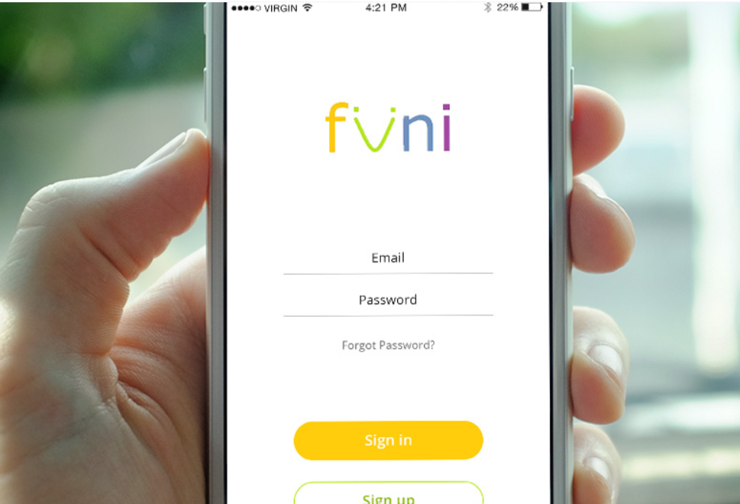
Example: Sign in page UI
Notes:
This example shows the UI design of an sign in page

Slide 5

Advanced Validation Techniques
Implementing Comprehensive Form Validation Strategies​
​ ​
Utilizing Regular Expressions and Data Validation Libraries ​
​ ​
Ensuring Error Prevention and User-Friendly Error Messages​
Notes:
Implementing Comprehensive Form Validation Strategies: Employing a combination of server-side and client-side validation techniques to ensure data integrity and prevent invalid submissions
Utilizing Regular Expressions and Data Validation Libraries: Leveraging regular expressions and data validation libraries to enforce specific input formats and data constraints
Ensuring Error Prevention and User-Friendly Error Messages: Designing clear and informative error messages that guide users towards correcting errors and improving data quality

Slide 6
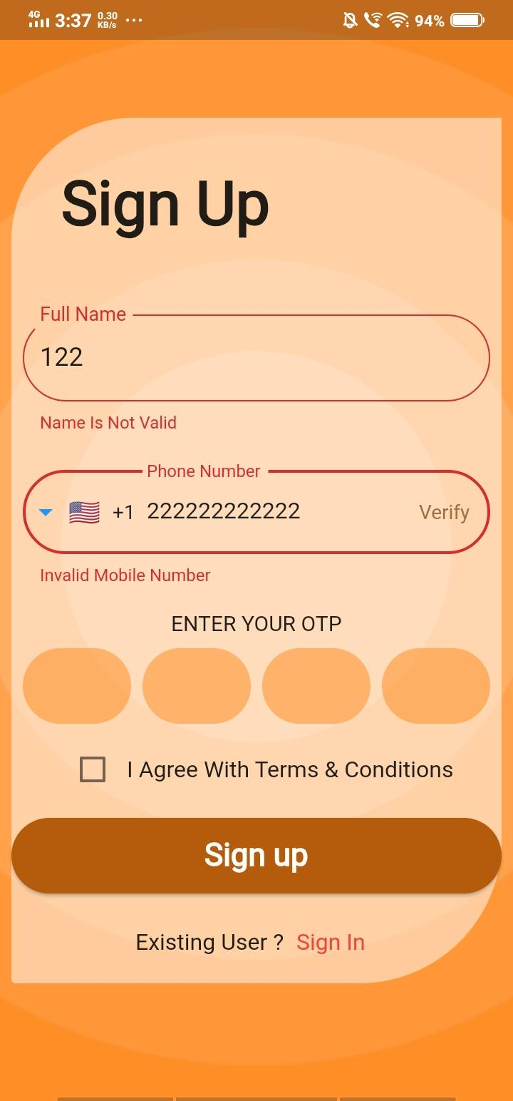
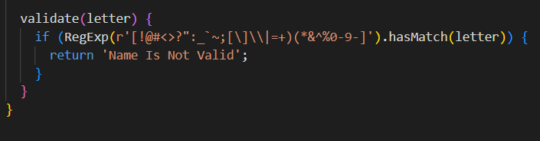
Example: Regular Expressions
Notes:
Creating Reg Exp Patterns
A regular expression constructs using a raw string (a sequence of characters preceded by the letter “r” such as r’I am a raw string’, r’12345String’, etc.). For example: RegExp(r’I am a RegExp’), RegExp(r’12345String’), RegExp(r'[0-9]\d+ab99′), etc. A RegExp will match as many occurrences as possible if it meets a given pattern.
Character Groups (\d, \w, \s, \D, \W, \S)
A character group is a symbol representing any character within a given set. For example, \d represents any single digit from 0-9, and \w stands for any alphanumeric character (including numbers and letters a-z, A-Z, 0-9). \s stands for any whitespace character (such as a space ‘ ‘, tab ‘\t’, or newline ‘\n’), \D is the opposite of \d and signifies any character that is not a digit.
In addition, \W is the opposite of \w and signifies any character that is not alphanumeric; \ S is the opposite of \s. It represents any character that is not a whitespace character and . signifies any character that is not a newline character (i.e., the end of a line, represented by \n).

Slide 7

Accessibility and Inclusive Design
Adhering to WCAG Guidelines and Best Practices​
Designing for Color Blindness and Visual Impairments​
​ ​
Considering Screen Reader Compatibility
Notes:
Adhering to WCAG Guidelines and Best Practices: Embracing WCAG (Web Content Accessibility Guidelines) to create accessible UIs that cater to users with diverse abilities and needs
Designing for Color Blindness and Visual Impairments: Implementing high-contrast color palettes, alternative text for images, and keyboard-navigable interfaces to ensure accessibility for visually impaired users
Considering Screen Reader Compatibility: Ensuring that UI elements and content are compatible with screen readers, providing an accessible experience for users with visual impairments

Slide 8

Theming and Branding
Establishing a Consistent and Cohesive Visual Identity​
Implementing Theming Mechanisms to Manage UI Styles and Colors​
​
Creating a Visually Appealing and Recognizable Brand Presence​
Notes:
Establishing a Consistent and Cohesive Visual Identity: Defining brand guidelines and a consistent visual style across the UI, including color schemes, typography, and iconography
Implementing Theming Mechanisms to Manage UI Styles and Colors: Utilizing theming mechanisms to separate UI styles from the underlying code, enabling easy customization and brand management
Creating a Visually Appealing and Recognizable Brand Presence: Designing a UI that is not only functional but also visually appealing and aligns with the brand's overall identity and values

Slide 9
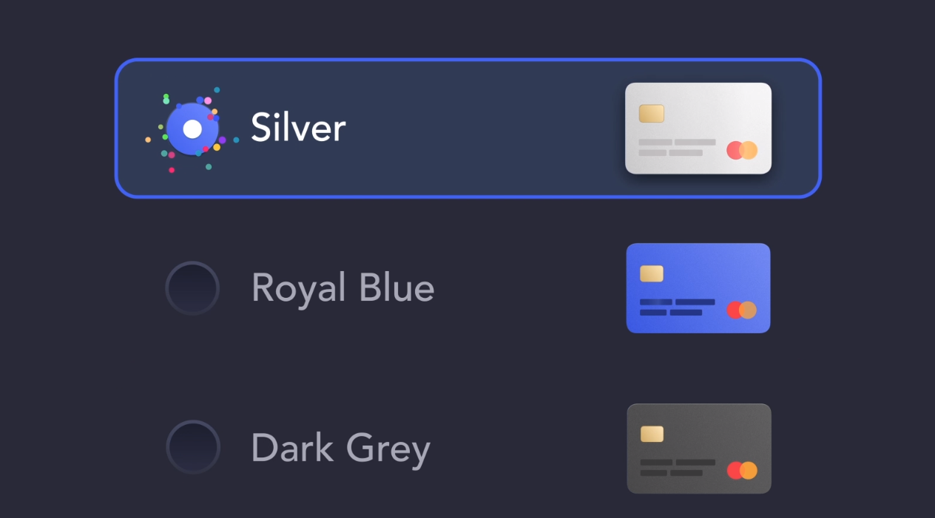
Example: Card Theme
Notes:
This example shows the card themes of three types Silver, Royal Blue and Dark Grey

